Slide 1



ROAD SIGNS
AND TRAFFIC LIGHT
DETECTION
BY: NOURAN ADEL
SALMA ALSAID
NADINE TAREK

Slide 2

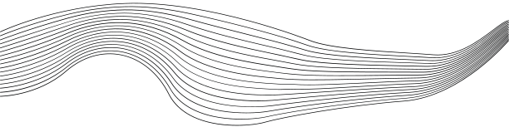
CONTENT
01
INTRODUCTION
02
GOALS AND OBJECTIVES
03
SOLUTION OVERVIEW
04
TECHNICAL APPROACH
05
CHALLENGES & SOLUTIONS
06
OUTPUT
07
FUTURE IMPROVEMENT
08
CONCLUSION

Slide 3
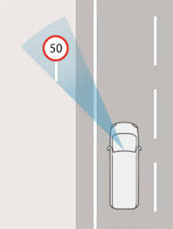


INTRODUCTION
This project focuses on leveraging artificial intelligence to enhance road safety by detecting road signs, labels them and traffic light signals , distinguishing between red and green lights, and displaying the results using pictures or videos.

Slide 4





GOALS AND OBJECTIVES
Facilitate the Adoption of Smart Transportation Technologies
Improve Real-Time Decision-Making
Model to detect road signs and Traffic lights

Slide 5




SOLUTION OVERVIEW
Implemented a machine learning model trained on a dataset from roboflow of road signs and traffic lights.
The model processes images or video streams to detect: Various road signs Traffic lights, distinguishing between red and green signals.
The results are displayed visually through images or video streams, enhancing user interaction.
AI MODEL
OUTPUT
DETECTION MECHANISM

Slide 6

TECHNICAL APPROACH
01
02
03
04
DATA
COLLECTION
MODEL
SELECTION
TESTING AND
VALIDATION
TRAINING
Road sign and traffic light datasets collected from Roboflow.
We used YOLOv5 for real-time detection of road signs and traffic lights, ensuring high accuracy and quick feedback.
The model was trained on labeled datasets of road signs and traffic lights, with specific labels for red and green signals.
Extensive testing was done to ensure accuracy in different lighting conditions and environments.

Slide 7
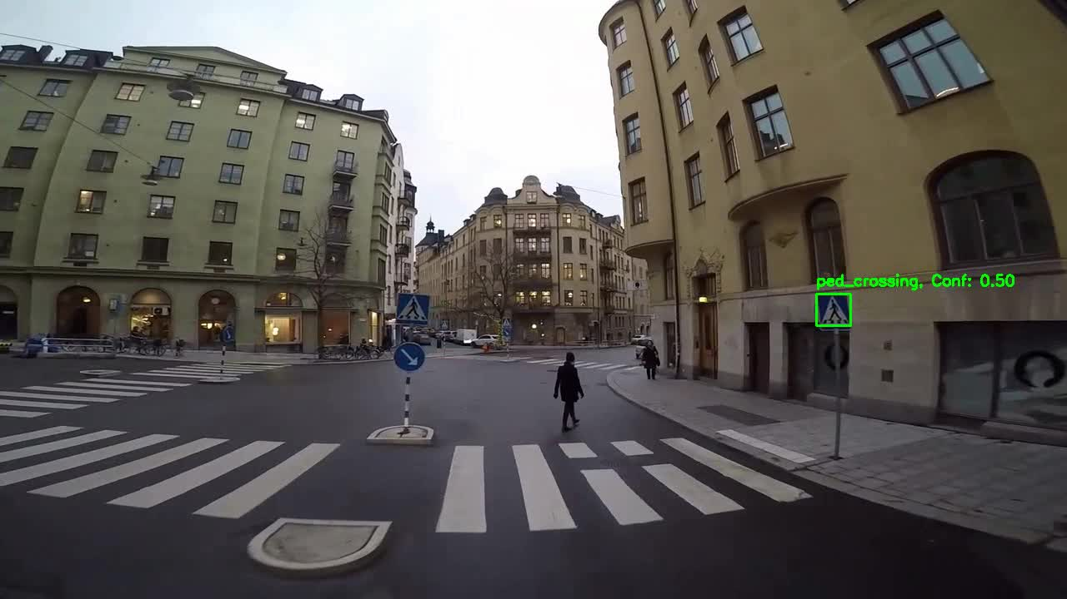
OUTPUT VIDEO 1

Slide 8
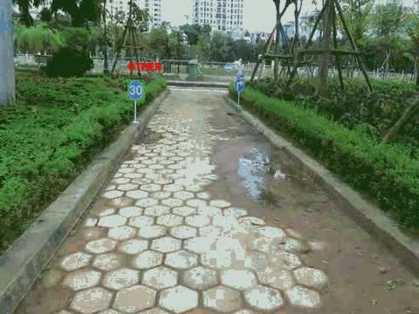
OUTPUT VIDEO 2

Slide 9


CHALLENGES & SOLUTIONS
Challenge :
During the road sign detection process, the initial model
struggled to accurately detect signs.
Solution:
To address this, we adjusted the training parameters, including image size, batch size, and epochs, and fine-tuned the hyperparameters using a custom configuration file.
The updated parameters included resizing images to 640x640 pixels, using a batch size of 16, and training for 100 epochs with optimized hyperparameters.
As a result, the model now detects road signs more accurately and its performance significantly improved.

Slide 10


FUTURE IMPROVEMENT
Expand the dataset to include a wider variety of road signs and conditions, which will help the model generalize better
Experiment with more advanced hyperparameter tuning and try different YOLOv5 architectures to boost performance. Incorporating data augmentation techniques will also be considered to improve robustness.

Slide 11

CONCLUSION
Successfully developed an AI model tem using YOLOv5 for real-time detection of road signs and traffic lights.
Demonstrated accurate and efficient detection, providing instant feedback from live video feeds.
We faced challenges with the model struggling to detect road signs accurately. By fine-tuning hyperparameters (image size, batch size, epochs), detection accuracy improved significantly.

Slide 12
REFERENCE:
DataSet:
https://universe.roboflow.com/roboflow-100/road-signs-6ih4y/dataset/2
Model:
https://github.com/ultralytics/yolov5

Slide 13
THANKS FOR WATCHING

